Slide 1

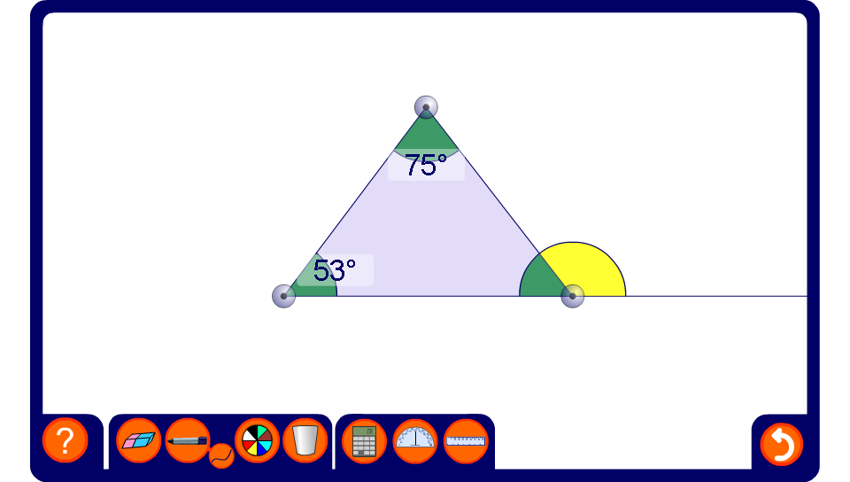


Interior and exterior angles in a triangle
Notes:
Drag the vertices of the triangle to show that the exterior angle is equal to the sum of the opposite interior angles.
Hide angles by clicking on them and ask pupils to calculate their sizes.
Be aware that the angles are rounded to the nearest degree and that this may cause a slight error of ±1°.

